Slide 1


“EXCEL DATA MANAGEMENT SYSTEM “
Dept. of CS&E ( DATA SCIENCE)
Adichunchanagiri Institute of Technology
Chikkamagaluru - 577102
Presented By,
Disha N H (4AI22CD018)
Shivani V (4AI22CD064)
Fathima Mehek (4AI22CD020)
Abhigna N Shetty (4AI22CD001)
Under the Guidance of
Prof. Harshitha H D

Slide 2
Problem Statement
To develop a application with a graphical user interface (GUI) to manage data from an Excel file which allows users to view, add, update, and delete data records stored in an Excel file, as well as visualize selected data through graphs.

Slide 3
Scope of the Project
Data Update: Users will be able to update existing student records using the unique USN (University Serial Number) as an identifier. This allows editing details for a specific student.
Data Entry: The system will allow users to input student details such as USN, Student Name, MongoDB Marks, PHP Marks, Data Structure Marks, Total Marks, and Percentage.
Data Deletion: Users will be able to delete student records based on the USN.
Data Persistence: All student data will be stored in an Excel file (Students.CSV), ensuring data is saved between application sessions.
CRUD Operations: The project will implement the basic Create, Read, Update, and Delete functionalities for student records.

Slide 4
Project Design
Hardware: A computer with at least 4GB RAM and basic storage.
Software: Python with Tkinter, pandas, and matplotlib libraries.
System Design:
The Excel Data Management System (EDMS) is designed to automate, organize, and streamline the management of data within Microsoft Excel.
The system will focus on automating repetitive tasks, improving data accuracy, ensuring data integrity, and facilitating the creation of reports and analysis.
The design of this system involves multiple components that work together to deliver these functionalities, ranging from user interfaces to backend processes.

Slide 5
System Architecture
+--------------------------------------------+
| User Interface |
| (Tkinter GUI: Entry Fields, Buttons, Tree)|
+----------------------+---------------------+
|
v
+---------------------------+
+-------------------+
| Application Logic Layer | | Data Storage | | (Python Functions) |<---->| (Excel File) |
+---------------------------+
+-------------------+
|
v
+----------------------------+
| Data Interaction Layer |
| (pandas for Excel I/O) |
+----------------------------+
|
v
+------------------------+
| Data Display Layer |
| (Treeview, Graph Plot)|
+------------------------+

Slide 6
Methodology
Steps or approach followed:
The user interacts with a Tkinter-based graphical user interface (GUI) to input student data, which is then added, updated, or deleted in an Excel file using Pandas.
The data is displayed in a Treeview widget, providing a tabular view, and can also be visualized as a bar chart using Matplotlib to show student percentages.

Slide 7
Technologies and Tools:
Python: The main programming language for the application.
Tkinter: For creating the GUI, with widgets such as Buttons, Labels, and Treeview.
Treeview: It is a UI component that displays hierarchical data in a tree structure, allowing users to expand or collapse nodes to navigate through the levels.
Pandas: For reading from and writing to Excel files, as well as handling data manipulations.
Matplotlib: For data visualization, plotting graphs based on selected data.

Slide 8
Implementation
Highlights of the code and database design:
Purpose: A Tkinter-based system to manage student records, providing an intuitive GUI for adding, updating, deleting, and visualizing data stored in an Excel file.
Database Design: Uses an Excel file (Student_Data.xlsx) with structured columns (USN, Student_Name, MongoDB, PHP, Data_Structure, Total_Marks, Percentage) as the backend database.
Key Features: CRUD operations (Create, Read, Update, Delete) with real-time updates displayed in a dynamic Treeview table.
Data Visualization: Bar graphs created using Matplotlib to display student performance based on percentages.

Slide 9
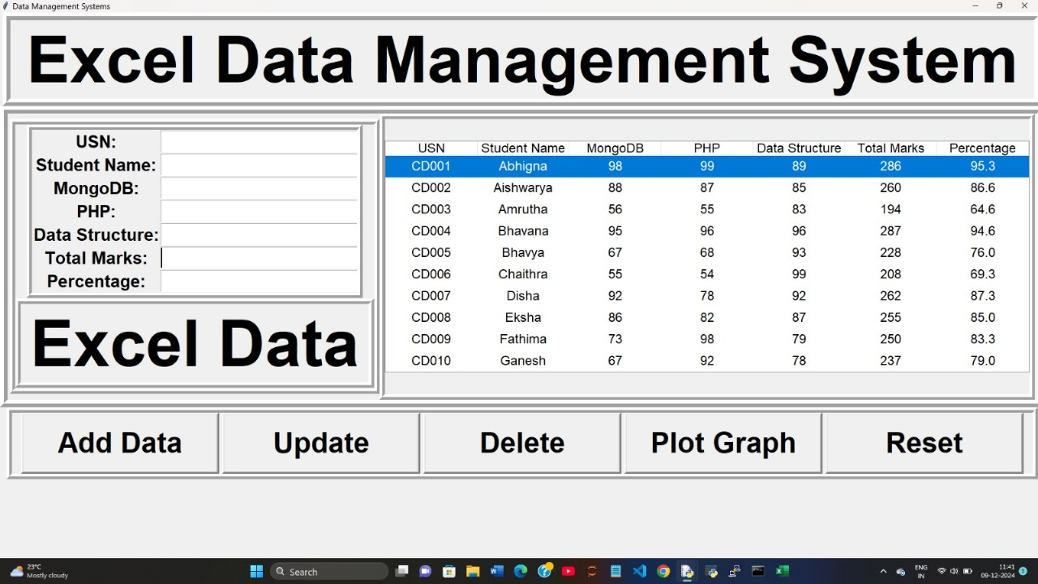
Results
An interactive Python-based Excel Data Management System with functionalities for data entry, updates, deletion, and graphical representation.

Slide 10
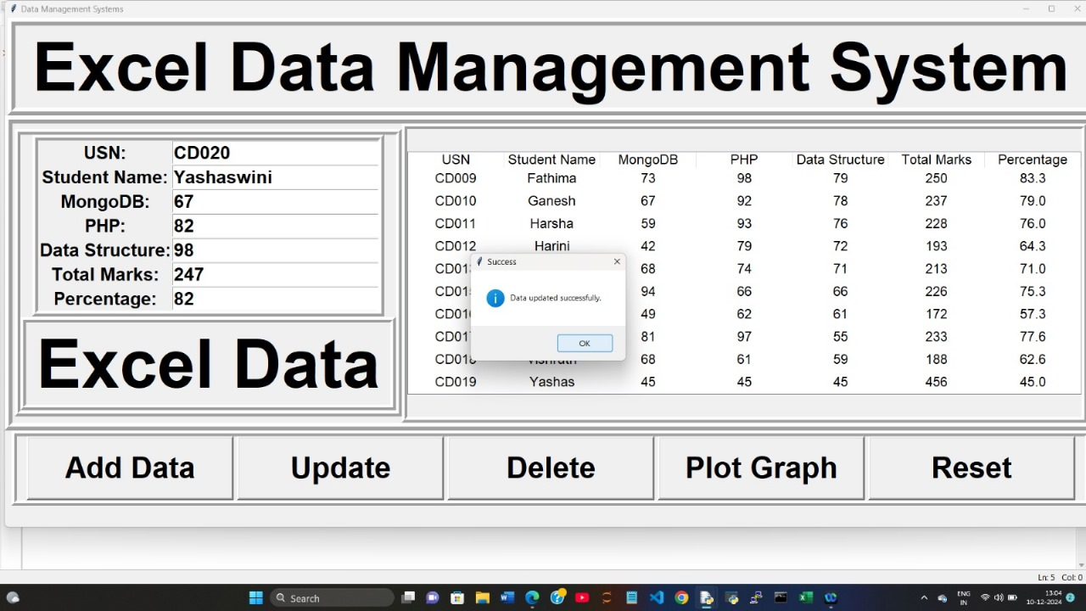
ADD DATA :
Effortlessly add student records with real-time feedback using the Excel Data Management System.

Slide 11
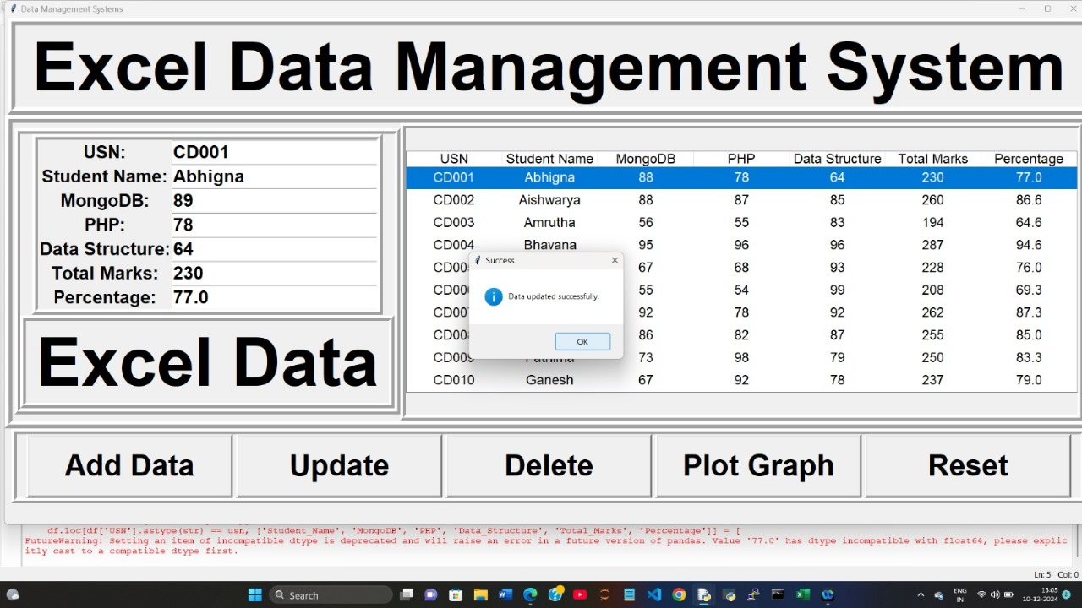
Update Data :
Effortlessly update student records with real-time feedback using the Excel Data Management System.

Slide 12
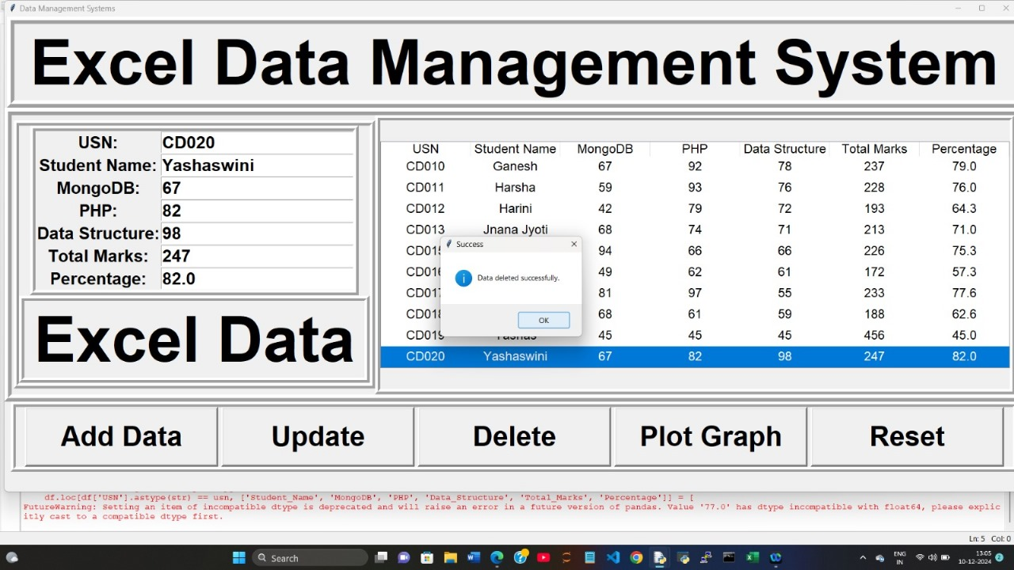
Delete Data :
Quickly delete records with ease using the Excel Data Management System.

Slide 13
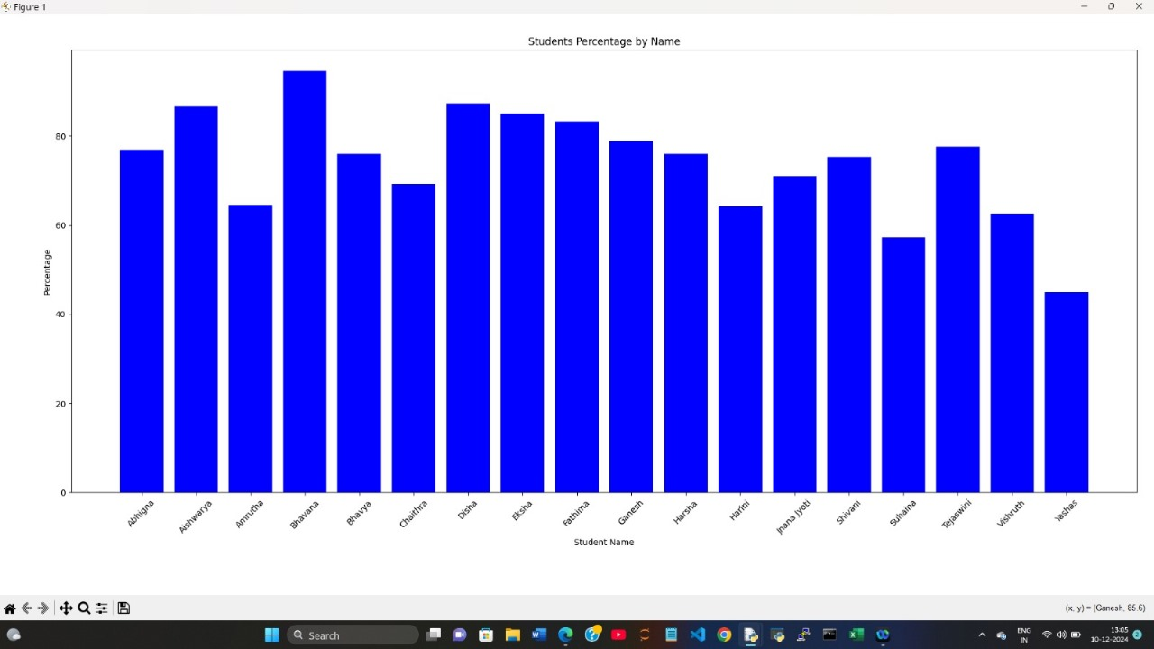
Plot Graph :
Visualize data effectively by plotting insightful graphs with the Excel Data Management System.

Slide 14
Challenges Faced
Issues Encountered:
File Handling: Missing or corrupted Student_Data.xlsx can cause errors; ensure file existence and validate columns.
Input Validation: Lack of checks for empty fields or duplicate USN allows invalid or redundant data.
GUI Responsiveness: Fixed layouts and blocking tasks make the interface unresponsive; use dynamic resizing and threading.

Slide 15
How They Were Resolved:
File Handling: Added checks to create Student_Data.xlsx if it doesn't exist and ensured consistent column names using pandas.
Input Validation: Implemented validation for empty fields and checks for duplicate USN before adding or updating records.
GUI Responsiveness: Enabled dynamic resizing with grid weights and optimized file operations using separate threads for heavy tasks.

Slide 16
Future Work
Database Integration: Replace the Excel file with a database like SQLite or MongoDB for improved scalability and performance.
Enhanced GUI: Add responsive design, tooltips, and real-time data validation for better user experience.
Data Analysis: Integrate advanced visualizations and analytics tools to provide insights beyond simple plotting.

Slide 17
Conclusion
Management Interface: This code creates a graphical user interface (GUI) using Tkinter to manage student data stored in an Excel file. It allows users to add, update, delete, reset, and view records.
Interactive Treeview Display: The data from the Excel sheet is displayed in a Treeview widget, enabling users to visually browse and select records for modifications.
Graphical Insights: A button is provided to generate bar charts of student percentages using Matplotlib, offering a quick overview of performance metrics.
Seamless Excel Integration: The program reads and writes data to an Excel file (Student_Data.xlsx) dynamically, ensuring persistent storage of updates.

Slide 18
GitHub Links
Abhigna N Shetty: https://GitHub.com/Abhignanshetty
Disha N H: https://GitHub.com/DishaNH31
Fathima Mehek: https://GitHub.com/FathimaMehek

Slide 19
THANK YOU

